Slide 1
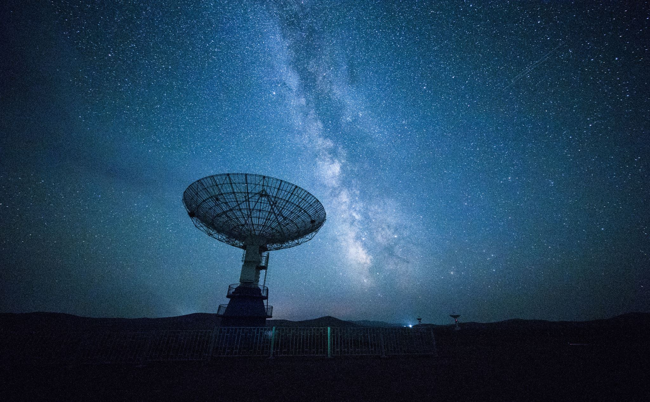
MICRO-STAR CABLE VISION
PRESENTED BY:
Shanya Connell, Abi Matthews-Gordon & Kyle White

Slide 2

THE COMPANY
Micro-Star CableVision, is a minor cable company in the Gordon Town area, that provides digital cable and internet access services. They first came to the market in the year 2015 and is known to provide top service in the following categories: Internet, Phone, Television and Broadband.

Slide 3

THE PROBLEM
The manager wants a complaint logging system that will be able to capture all customer complaints and queries. Upon receipt of a complaint, a customer service representative will log the complaint and assign/schedule a service technician to visit the site to rectify the issue.

Slide 4
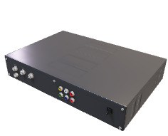
OUR JOB
We were hired to build a TCP/IP socket-based Client/Server architecture application that will
facilitate the above problem. Our Client application will send requests to the server
application, as only the server application can establish connections to the database. The
client application will consist of a GUI.
Our system will also capture all data about Customers, Representatives, Technicians and
Complaints.
.

Slide 5
Milestone 1: Database Design & Domain
DERIVED TABLES:
Address
User
Customer
Employee
Account
Payment
Service
Bill
Complaint
Response
Visit
Message

Slide 6
Milestone 1: Database Design & Domain
Fields for each table:
MESSAGE:
messageID
read
text
Date
RELATIONSHIP:
OneToMany with complaints
OneToMany with user

Slide 7
Milestone 1: Database Design & Domain
Fields for each table:
USER:
userID
password
firstName
lastName
middleName
Age
gender
RELATIONSHIP:
OneToOne with message
IS A with customer & employee

Slide 8
Milestone 1: Database Design & Domain
Fields for each table:
CUSTOMER:
userID
email
address
RELATIONSHIP:
OneToOne with user
OneToOne with address
OneToMany with account

Slide 9
Milestone 1: Database Design & Domain
Fields for each table:
EMPLOYEE:
userID
role
status
RELATIONSHIP:
OneToOne with user
OneToMany with employeeVisit
OneToMany with employeeCompllaint

Slide 10
Milestone 1: Database Design & Domain
Fields for each table:
ADDRESS:
addressID
town
parish
state
RELATIONSHIP:
OneToOne with customer

Slide 11
Fields for each table:
ACCOUNT:
accountID
accountStatus
amountDue
customerID
RELATIONSHIP:
OneToOne with customer
OneToMany with payment
OneToMany with service
OneToMany with complaint
Milestone 1: Database Design & Domain

Slide 12
Milestone 1: Database Design & Domain
Fields for each table:
PAYMENT:
paymentID
paymentStatus
paymentDueDate
accountID
RELATIONSHIP:
OneToOne with account

Slide 13
Milestone 1: Database Design & Domain
Fields for each table:
SERVICE:
serviceID
typeOfService
dateInitiated
status
accountID
RELATIONSHIP:
OneToOne with account
OneToMany with bill

Slide 14
Milestone 1: Database Design & Domain
Fields for each table:
BILL:
billID
date
periodStart
periodEnd
amount
due
serviceID
RELATIONSHIP:
OneToOne with Service

Slide 15
Milestone 1: Database Design & Domain
Fields for each table:
RESPONSE:
responseID
detail
responseDate
complaintID
RELATIONSHIP:
OneToOne with complaint

Slide 16
Milestone 1: Database Design & Domain
Fields for each table:
COMPLAINT:
complaintID
status
detailOfIssue
typeOfIssue
dateRaised
accountID
RELATIONSHIP:
OneToMany with employeeComplaint
OneToOne with account
OneToMany with complaintVisit
OneToOne with message

Slide 17
Milestone 1: Database Design & Domain
Fields for each table:
VISIT:
visitID
dateOfVisit
scheduleDate
complete
RELATIONSHIP:
ZeroToMany with complaijntVisit
OneToMany with EmployeeVisit

Slide 18
Milestone 1: Database Design & Domain
Fields for each table:
PAYMENT:
paymentID
paymentStatus
paymentDueDate
accountID
RELATIONSHIP:
OneToOne with account

Slide 19
Milestone 1: Database Design & Domain
Constraints:

Slide 20
Milestone 1: Database Design & Domain
Normalised Tables:
Complaint(complaintID, status, detailOfIssue, typeOfIssue, dateRaised, accountID)
Fk accountID references Account
Message(messageID, read, text, date, recepientID, senderID, complaintID)
Fk recepientID references User
Fk senderID references User
Fk complaintID references Complaint
Payment(paymentID, paymentStatus, paymentDueDate, accountID)
Fk accountID references Account

Slide 21
Milestone 1: Database Design & Domain
Normalised Tables:
Service(serviceID, typeOfService, dateInitiated, status, accountID)
Fk accountID references Account
Bill(billID, date, periodStart, periodEnd, amount, due, serviceID)
Fk serviceID references Service
Visit(visitID, dateOfVisit, scheduleDate, complete)
Employee(userID, role, status)

Slide 22
Milestone 1: Database Design & Domain
Normalised Tables:
EmployeeVisit(employeeVisitID, visitID, empID)
Fk visitID references Visit
Fk empID references Employee
EmployeeComplaint(employeeComplaintID, empID, complaintID)
Fk empID references Employee
Fk complaintID references Complaint

Slide 23
Milestone 1: Database Design & Domain
Normalised Tables:
ComplaintVisit(complaintVisitID, complaintID, visitID)
Fk complaintID references Complaint
Fk visitID references Visit
Response(responseID, detail, responseDate, complaintID)
Fk complaintID references Complaint

Slide 24
Milestone 1: Database Design & Domain
UML:

Slide 25
Milestone 1: Traditional Database Connectivity
Hibernate 5.4 was used for the CRUD operations
Log4j2 was used to manage and log all exceptions

Slide 26
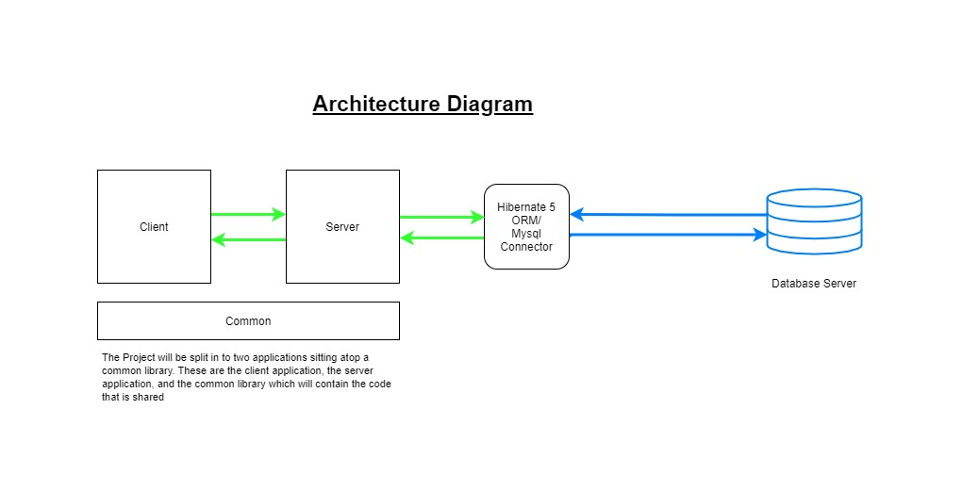
Milestone 1: Object-Relational Mapping

Slide 27
Milestone 2: Events Logging
5 loggers:
EmployeeAccess- tot track employee activity
2. CustomerAccess- to track customer activity
Error- for all errors
ViewRecords- to track when records are pulled from the database and viewed
Connection- to track all connections to client and server.

Slide 28
Milestone 2: Version Control / Continuous Integration
A repository on GitHub was created and every member was added as a collaborator.
The method to push the repository was different for each member and based upon the ide used.
The repository consists of 4 branches: main, Shae, abi-local-development and pilot. Eavh member pushes code to their branch which is then reviewed and then added to the main branch.

Slide 29
A class was created with variables and methods common to both Client and Server.
Client
This has 3 methods:
1. createConnection- creates the socket to connect to the Server using the IP address and Server port.
2. sendRequest- takes a ServerRequest and writes the object to the Server.
3. receiveResponse- receives the object sent by the Server and returns it to the function waiting on a response.
Server
This has 2 methods:
createConnection- this attempts to set up the ServerSocket using the Server port.
waitForRequest- here the Server waits for incoming Connections; when accepted, a new thread is
Milestone 3: TCP/IP Socket-based Networking and Object Serialization

Slide 30
Milestone 3: TCP/IP Socket-based Networking and Object Serialization
To send serialized objects over network streams two classes were created:
ServerRequest and ServerResponse.
Server requests and Server responses sre sent and received using objectoutput and objectinput streams respectively.

Slide 31
Milestone 3: Multi-Threading
A class called MultipleClientHandler was created to manage multiple client requests. The class accepts the connection socket of the client. The class that proceeded to accept the ServerRequest being sent by a client. Based on the command of the request sent, the class calls the function required to produce a response to be sent back to the client.

Slide 32
Milestone 3: Advanced Graphical User Interface

